Slide 1
Advanced topics in machine learning SEMESTER PROJECT Group 17
Genre Identification on (a sub-set of) Gutenberg Corpus
Sinchana Eshwarappa Prameela
Divya Sasidharan
Saied Akbar Ahmady
Mondher Hentati
Poornima Venkatesha
July 1, 2020

Slide 2
Contents
MOTIVATION
1
ALGORITHMS
3
EVALUATION
DATA SET
2

Slide 3
Motivation
Task: Multi-class text classification
Build a classification model
Classify books based on its genre
What makes each genre different?
What features do we need to extract to classify a book to its correct genre?
How can we solve the class imbalance problem present in the data set?
Handcrafted Features
Bag of Words/ TF - IDF

Slide 4
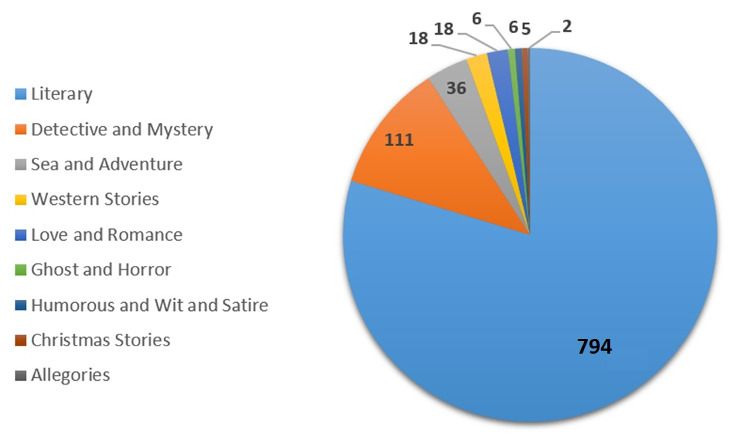
Dataset
Selected 19th century English fiction books
Total 996 HTML files/books belonging to 9 genres
Class imbalance issue

Slide 5
IMPLEMENTATION
Python 3
Latest NLTK (v3.5) library, scikit-learn v0.23, imbalanced-learn API
POS Tagging: nltk.pos_tag()
Named Entity Recognition: nltk.ne_chunk()
Sentiment Analysis: SentimentIntensityAnalyzer().polarity_scores()
(from nltk.sentiment.vader)
Imbalanced data: Synthetic Minority Oversampling TEchnique (SMOTE)
Models trained
Multinomial Naïve – Bayes
Decision Tree
Random Forest
Model selection
5 Fold Cross Validation

Slide 6
Pre-processing
Raw data: HTML (semi-structured)
Ignore empty files
Tokenization: word + punctuation tokens
No stopword removal and stemming
Lemmatization
Hand-crafted feature extraction and representation

Slide 7
Feature Extraction
Feature type | Feature
1. Writing style | Paragraph count, Female pronoun count, Male pronoun count, Semi colon count, Average sentence length, All POS tags
2. Sentence Complexity | Average sentence length, POS tags (Comma, Period, Punctuation, Conjunction)
3. Female oriented | Female pronoun count
4. Male oriented | Male pronoun count
5. Setting | POS tags (Quotes), Persons count, Locations count
6. Sentiment | Compound score, Negative, Neutral, Positive
7. Plot complexity | Persons count, Locations count

Slide 8
NAN values in each feature

Slide 9
Handling features with NAN Values
Dropped features with many NAN values
Filled few NAN Values of features with mean
Cleaned Feature set
removed features
# | ( | ) | LS | $ | SYM | NNPS | FW | WP$
Filled NAN values with the average
RBS | PDT | `` | UH | ' | PRP | VBD | RP | PRP$
CD | VBZ | VB | JJR | VBP | RB | MD | WRB | VBG
WDT | : | VBN | NNS | JJS | RBR | EX | WP | location_count
47 features remain

Slide 10
Class Imbalance Issue
All the classes are of same importance
Handled by Over-sampling the minority classes
Over Sampling
Cross Validation
Proper Metrics
from imblearn.over_sampling import SMOTE
SMOTE(random_state = 42, k_neighbors = 1)

Slide 11
Oversampling

Slide 12
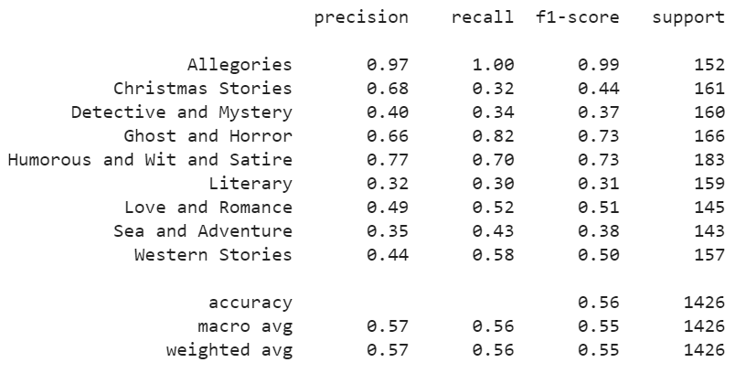
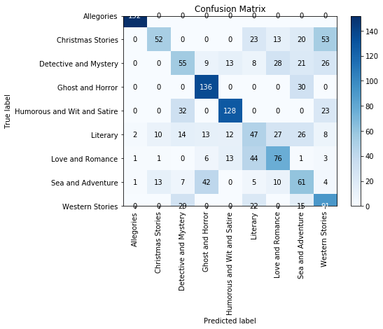
Multinomial Naive Bayes Classifier
Result of 5-fold cross validation:
Accuracy: 0.570

Slide 13
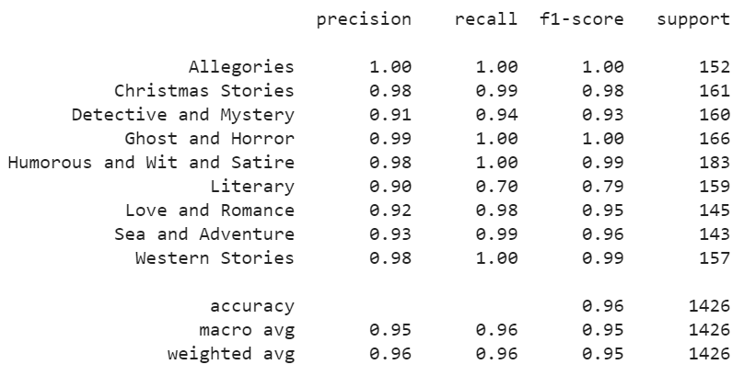
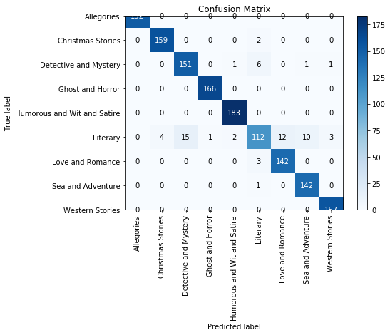
Decision Tree Classifier
Result of 5-fold cross validation:
Accuracy: 0.951

Slide 14
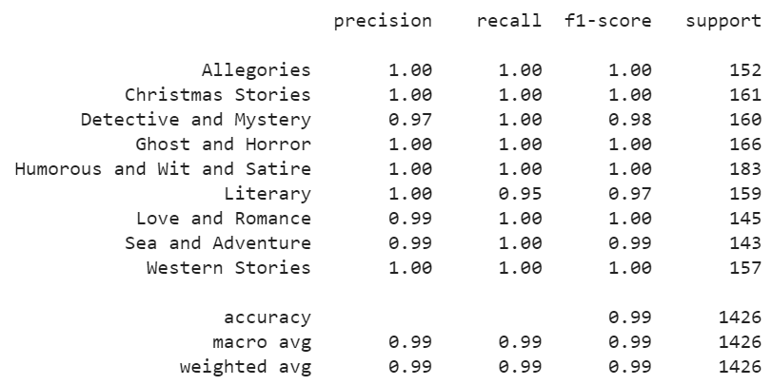
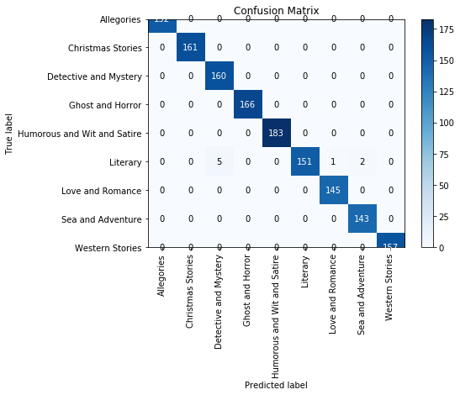
Random Forest Classifier
Result of 5-fold cross validation:
Accuracy: 0.993

Slide 15
Limitations and challenges
Limitations
Sentiment analysis performed on book level, which did not give useful results as sentiment varies throughout a book
Did not compare with a baseline BOW / TF-IDF model
Challenges
Handcrafted feature representation and extraction – selecting relevant features and the assumptions made
Class imbalance (solved by over-sampling)

Slide 16
Thank you

